Slide 1




SiteSage
Retail Site Selection
Yaowen Liu, Guan Zheng Huang

Slide 2
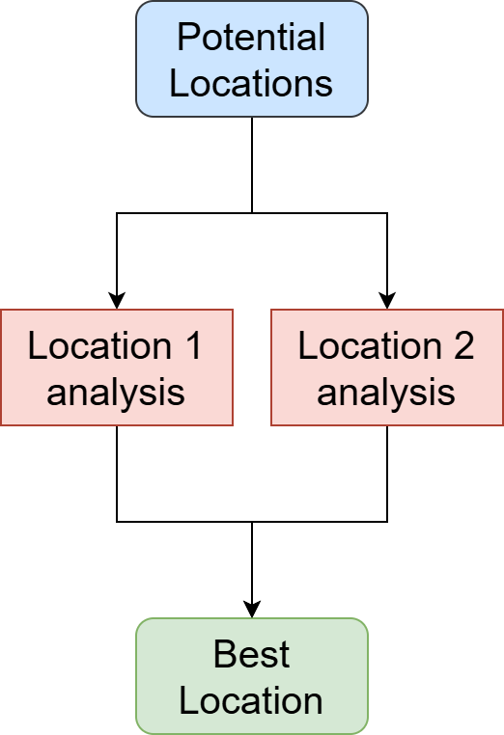
Introduction
SiteSage
Revenue
Site selection greatly impact
⛔complex, ⛔large data volume, ⛔experience-driven
⚠️expensive, ⚠️slow, ⚠️subjective
Input: Store description, location (s)
Output: Structured, data-driven reports and scores
Feature: internet access, geospatially aware, guided
✅real-time data, ✅fast, ✅explainable, ✅comparable
💲💲💲
Notes:
40s
Traditional site selection depends on experience from the experts and locals, which is comparatively subjective
While Modern site selection utilizes data-driven tools such as geographic information system and machine learning to project a location to potential revenues, however it is still labor-intensive and expensive
The goal of the siteSage is to automate data analysis and expert analysis
SiteSage is an agentic system… it takes … and outputs

Slide 3


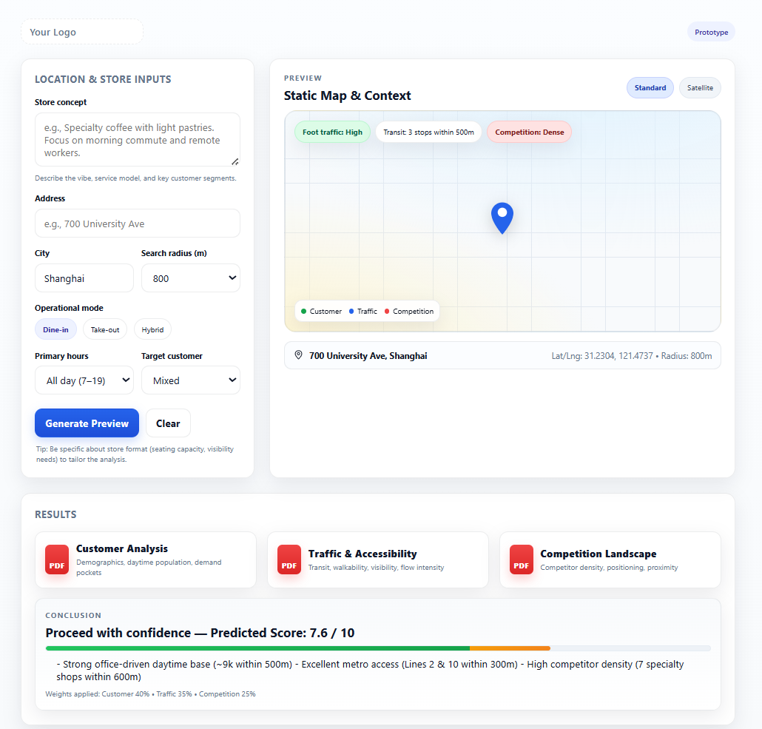
User Experience
SiteSage
End-to-end web app
Enter description
Enter location (s)
Note Map preview
Note Per-stage report
Read summary and report
Score given against rubric
Qualitative explanation

Slide 4
Data and Access
SiteSage
Agent accessible
For Evaluation
Amap API | geocoding, static map, nearby search
WorldPop API | population, age, gender
Open Internet | general information and public data (reviews, POIs)
Dianping API | store ratings & 30-day review → estimate traffic
Notes:
20s
The agent is accessible to the following data
Amap api
World pop demographics
Open Internet data
For evaluation, we use dianping to get store ratings and reviews as a proxy to project the customer traffic of stores.

Slide 5
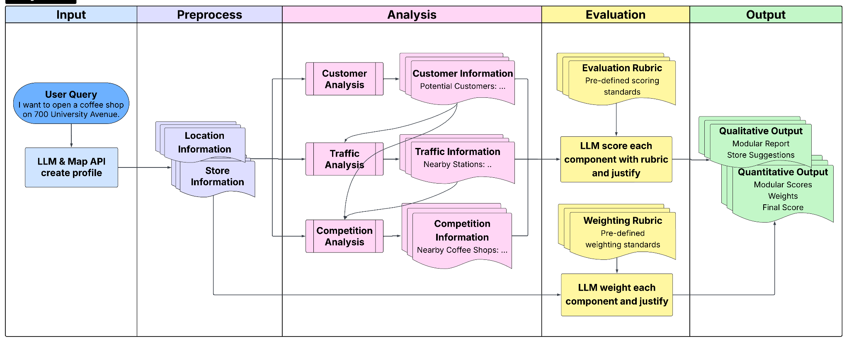
Architecture: System Workflow
SiteSage
Notes:
45s
This is the architecture of the SiteSage
It takes in user’s description of the store and location, preprocess the information to structured inputs for 3 consecutive analysis modules:xxx
Each module takes in the report from the previous module and generates a report based on instruction, and then llm scores each component with predefined rubric and justify
On the other side, store information will be analyzed as weights for each module with predefined weighting rubric
Together with analysis reports, the framework outputs qualitative and quantitative results for the user.

Slide 6
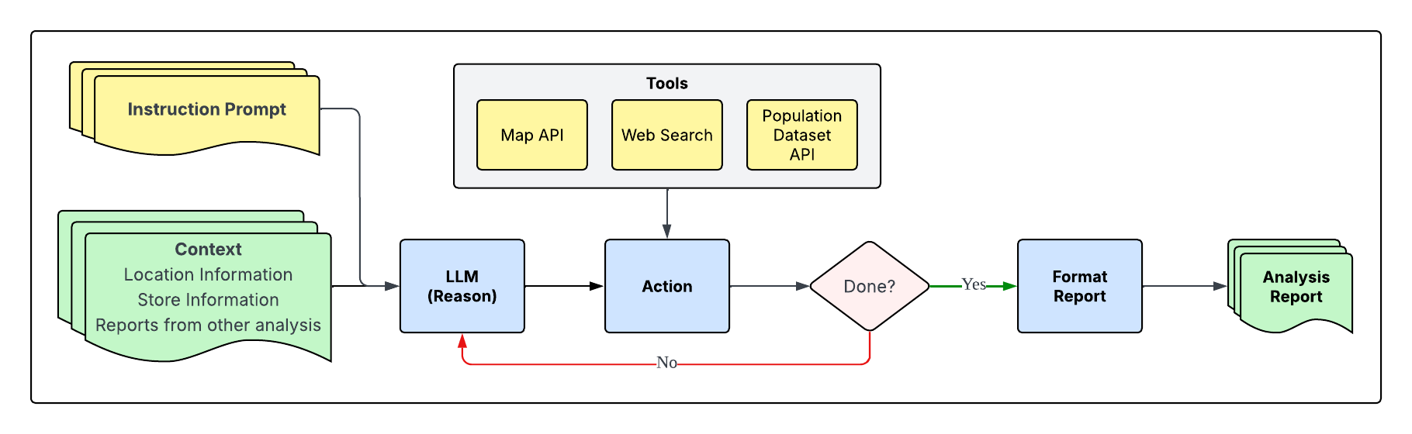
Architecture: Agent Design
SiteSage
Customer, Traffic, Competition Analysis modules.
ReAct Paradigm: Reason and Act.
Notes:
In terms of design for customer, traffic and competition analysis modules, we choose a Reason and act framework.
In this framework, LLM takes context and instruction as input and iterates the process of reason and action until it thinks the process is done, and then it outputs the formatted report.

Slide 7



Risks
SiteSage
ID | Risk Name | Cause | Mitigation
H1 | Internet Data Drift | Data not recent | Prompt date limit, rule-based filter.
H2 | Data Availability | Limited open data | Limit scope, provide api to key data source.
H5 | Hallucination | - | Better models, RAG and force reference use.
H6 | Bad input | Description not clear | Educate effective input, provide granular-entry fields.

Slide 8
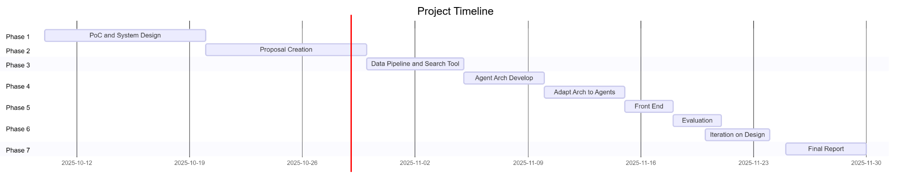
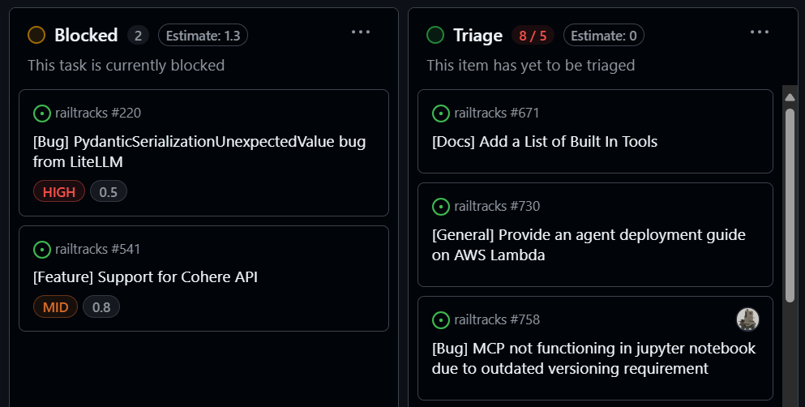
How and When
SiteSage
Waterfall | Kanban board | Pair-coding
Complete Agent
End-to-End
Delivery
Nov 14
Nov 17
Dec 24

